Slide 1

Skating Merit Badge
Skateboarding Option
Troop 344 and 9344
Pemberville, OH

Slide 2
Internet access is necessary for viewing the online tutorials of the various skating skills.
If you are a Scout, please obtain parental permission before viewing the videos.

Slide 3
Skating Merit Badge Requirements
Do the following:
  Explain to your counselor the most likely hazards associated with skating and what you should do to anticipate, help prevent, mitigate, and respond to these hazards.
  Show that you know first aid for injuries or illnesses that could occur while skating, including hypothermia, frostbite, lacerations, abrasions, fractures, sprains and strains, concussions, blisters, heat-related reactions, and shock.

Slide 4
Skating Merit Badge Requirements
Complete ALL of the requirements for ONE of the following options,
  Skateboarding
    Explain the following to your counselor:
      History and evolution of skateboarding
      Benefits of skateboarding (physical fitness, balance, coordination, perseverance, and creativity)
      Purpose of skateboarding safety and protective gear (helmets, knee pads, elbow pads, wrist guards)
    Explain the following to your counselor:
      Rules and regulations of skateparks
      Understanding skatepark zones (street, bowl, and ramp)
      Right-of-way and respect for others
      Communication signals and warnings

Slide 5
Skating Merit Badge Requirements
Complete ALL of the requirements for ONE of the following options,
  Skateboarding
  Do the following:
      Explain skateboard anatomy (deck, trucks, wheels, bearings)
      Build a board by assembling all pieces (deck, wheels, trucks, bearing, and grip tape) in the proper order
      Explain skateboard maintenance (cleaning, tightening bolts, and replacing parts)
  Demonstrate the following skateboarding skills:
      Stance and foot placement (regular and goofy)
      Pushing and balance
      Turning and carving
      Braking and stopping techniques
      Ollies (basic and variations)

Slide 6
Skating Merit Badge Requirements
Complete ALL of the requirements for ONE of the following options,
  Skateboarding
  Demonstrate a total of three skateboarding tricks from the following types:
      Flatland tricks
      Flip and shove-it tricks
      Grind and slide tricks
      Air, grab, bowl and ramp tricks
      Footplant tricks
      Balance tricks

Slide 7
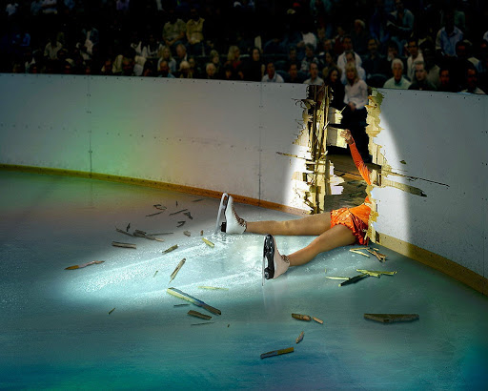
Requirement 1a
  Explain to your counselor the most likely hazards associated with skating and what you should do to anticipate, help prevent, mitigate, and respond to these hazards.

Slide 8
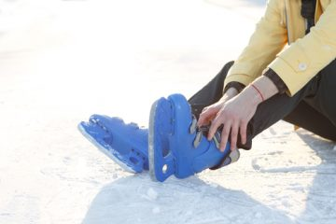
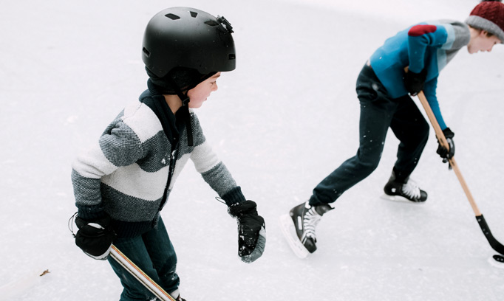
Hazards of Skating
Ankle Sprains & Fractures
The intense weight and pressure placed upon the ankles during skating activity makes them susceptible to sprains and fractures.
Head Injuries
When a loss of balance or control occurs, head injuries are a common and serious consequence. The ice surface is very dangerous as there is no cushion against impact. These skating injuries may include concussions or other traumatic brain injuries. Wear a helmet!

Slide 9
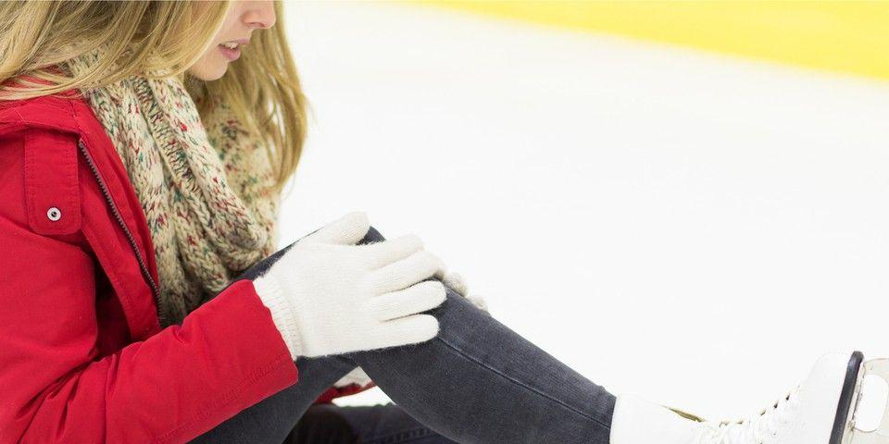

Hazards of Skating
(continued)
ACL Tears
The anterior cruciate ligament (ACL) runs diagonally through the middle of the knee and provides rotational stability. A traumatic injury, such as those commonly sustained during ice skating, can cause a tear of the ACL or surrounding menisci.
Lacerations
Sharp blades. Hard ice. Speed and precise movements. These combined factors put ice skaters at risk of lacerations of varying degrees of severity.

Slide 10
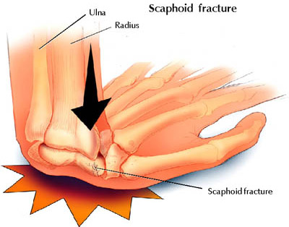
Hazards of Skating
(continued)
Hand and Wrist Injuries
When we experience a slip or fall, our immediate instinct is to put our hands out to catch ourselves--which is good, because it protects the more important head and face. But it can also result in serious injury to the hand or wrist from the force of the impact.

Slide 11
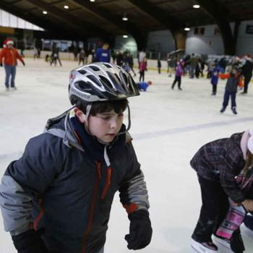
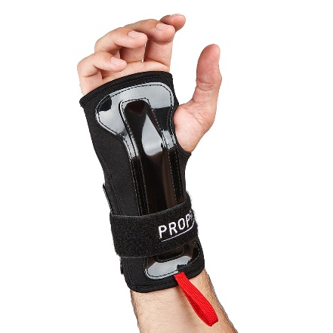
Skating Safety Tips
Proper Equipment
Many of the orthopedic skating injuries that are commonly suffered can be prevented by simply wearing proper equipment; that may include padding, helmets, and--of course--quality skates.
Proper Fit
Skates that do not fit properly contribute to a high number of skating injuries; they may cause stress to bones, muscles, and ligaments, as well as imbalance.

Slide 12
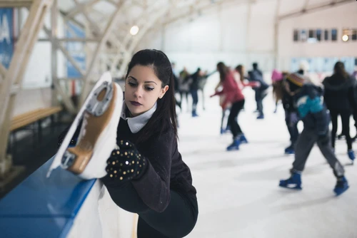
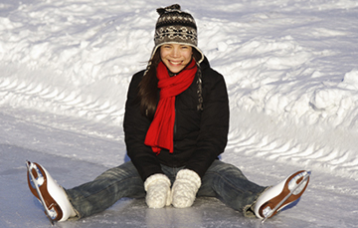
Skating Safety Tips
(continued)
Warm Up Thoroughly
Cold muscles and ligaments are more brittle and prone to tears and injury. Warming up can help to loosen your muscles, tendons, and ligaments and help to prevent tears.
Avoid Extreme Exposure
Wear adequately warm clothing--thick layers and a waterproof shell. And pay attention to changing weather. If you start to feel uncomfortable or chilled, it’s time to end your activity and return to warm shelter.

Slide 13
Requirement 1b
  Show that you know first aid for injuries or illnesses that could occur while skating, including hypothermia, frostbite, lacerations, abrasions, fractures, sprains and strains, concussions, blisters, heat-related reactions, and shock.

Slide 14

First Aid for Hypothermia
Gently remove wet clothing.
Replace wet things with warm, dry coats or blankets.
If further warming is needed, do so gradually.
  For example, apply warm, dry compresses to the center of the body — neck, chest and groin.

Slide 15
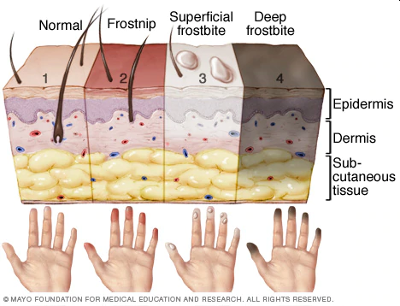
First Aid for Frostbite
Warm the frostbitten parts in warm (not hot) water for about 30 minutes.
Place clean cotton balls between frostbitten fingers and toes after they've been warmed.
Loosely wrap warmed areas with clean bandages to prevent refreezing.
Give acetaminophen or ibuprofen for pain.

Slide 16
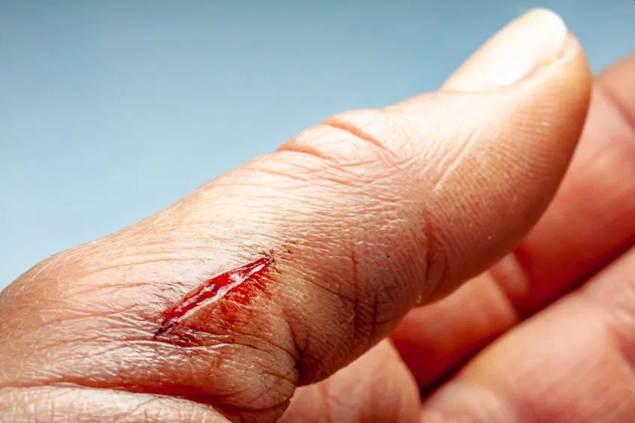
First Aid for Lacerations
Stop the Bleeding by apply direct pressure on the area if necessary.
Clean the area with warm water and gentle soap.
Apply an antibiotic ointment to reduce chance of infection.
For a minor laceration, remove the bandage after a couple of days to promote healing.
Call a health care provider if:
  The cut is deep or over a joint
  If the cut doesn't heal or shows signs of infection, including redness, swelling, pus, or excessive pain.

Slide 17
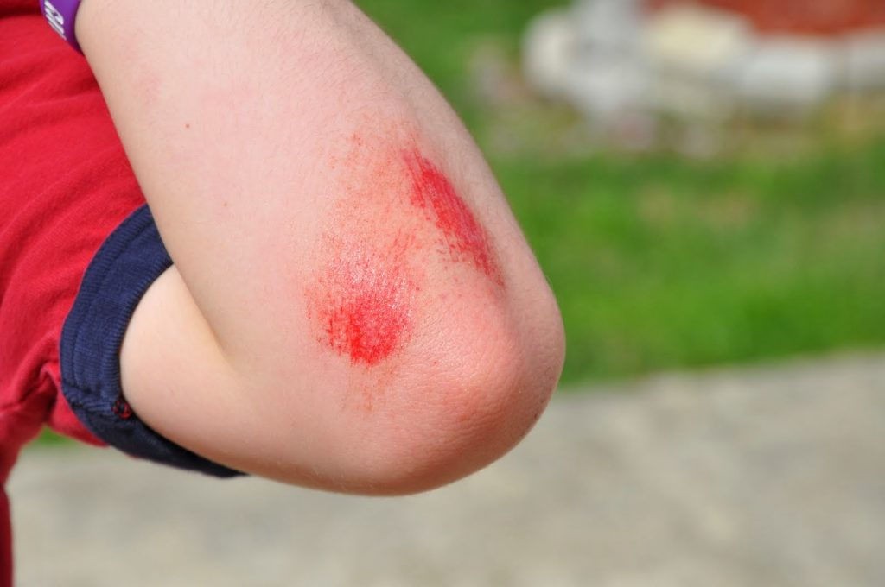
First Aid for Abrasions
Gently clean the area with cool to lukewarm water and mild soap.
Remove dirt or other particles from the wound using sterilized tweezers.
Apply an antibiotic ointment to reduce chance of infection.
Cover it with a clean bandage or gauze.
Gently clean the wound and change the ointment and bandage once per day.
Watch the area for signs of infection, like pain or redness and swelling.
See your doctor if you suspect infection.

Slide 18
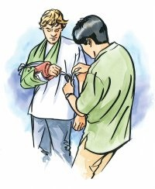
First Aid for Fractures
Stop any bleeding: If they’re bleeding, elevate and apply pressure to the wound using a sterile bandage, a clean cloth, or a clean piece of clothing.
Immobilize the injured area: If you suspect they’ve broken a bone in their neck or back, help them stay as still as possible. If you suspect they’ve broken a bone in one of their limbs, immobilize the area using a splint or sling.
Apply cold to the area: Wrap an ice pack or bag of ice cubes in a piece of cloth and apply it to the injured area for up to 10 minutes at a time.
Treat them for shock: Help them get into a comfortable position, encourage them to rest, and reassure them. Cover them with a blanket or clothing to keep them warm.
Get professional help: Call 911 or help them get to the emergency department for professional care.

Slide 19
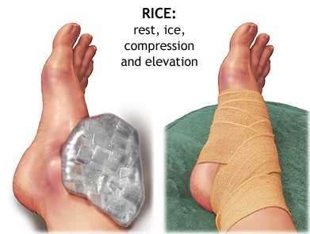
First Aid for Sprains and Strains
Rest the sprained or strained area. If necessary, use a sling for an arm injury or crutches for a leg or foot injury. Splint an injured finger or toe by taping it to an adjacent finger or toe.
Ice for 20 minutes every hour. Never put ice directly against the skin or it may damage the skin. Use a thin towel for protection.
Compress by wrapping an elastic (Ace) bandage or sleeve lightly (not tightly) around the joint or limb. Specialized braces, such as for the ankle, can work better than an elastic bandage for removing the swelling.
Elevate the area above heart level if possible.
Manage pain and inflammation with ibuprofen or acetaminophen
All but the most minor strains and sprains should be evaluated by a doctor.

Slide 20
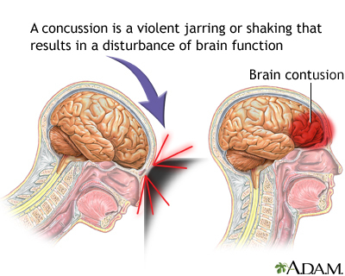
First Aid for Concussions
Immediately stop the activity.
Monitor the person for changes in symptoms.
Keep them calm and quiet.
Seek medical evaluation if symptoms persist or worsen.

Slide 21
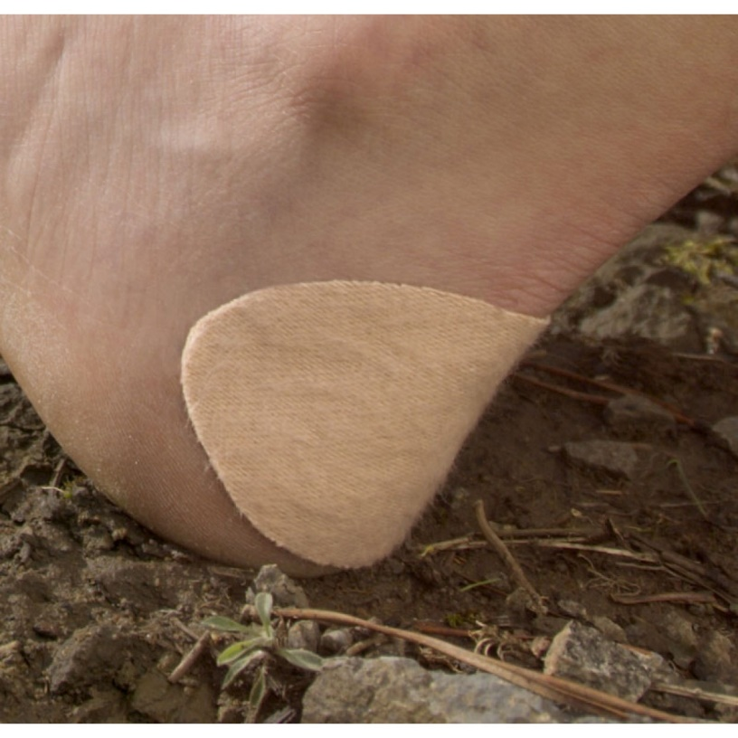
First Aid for Blisters
If a blister isn't too painful, try to keep it intact.
Unbroken skin over a blister may provide a natural barrier to bacteria and decreases the risk of infection.
Cover it with an adhesive bandage or moleskin.

Slide 22
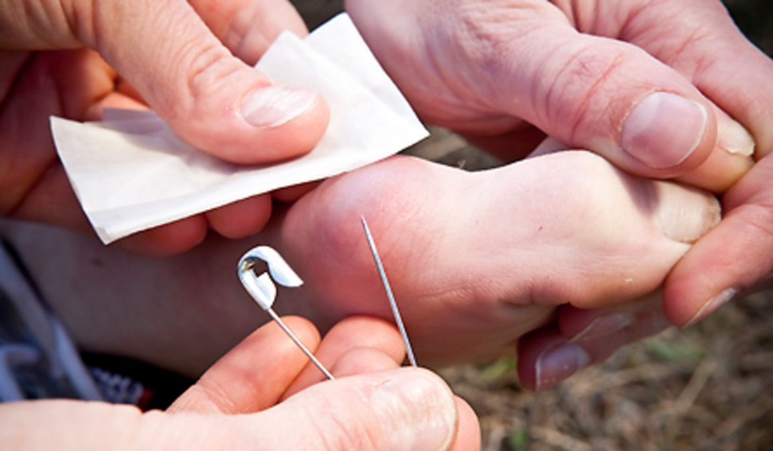
First Aid for Blisters
To relieve blister-related pain, drain the fluid while leaving the overlying skin intact.
Wash your hands and the blister with soap and warm water.
Swab the blister with iodine.
Sterilize a clean, sharp needle by wiping it with rubbing alcohol.
Use the needle to puncture the blister. Aim for several spots near the blister's edge. Let the fluid drain, but leave the overlying skin in place.
Apply an antibiotic ointment to the blister and cover it with a nonstick gauze bandage.
Follow-up care. Check the area every day for infection. Apply more ointment and a bandage.

Slide 23
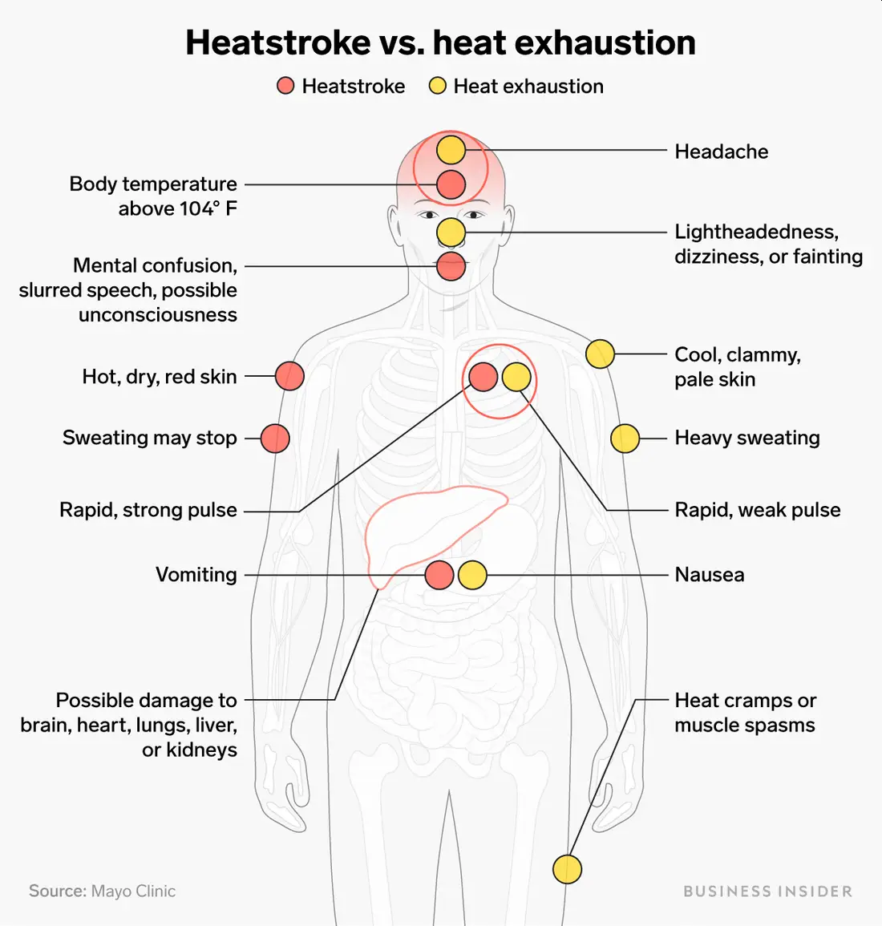
Symptoms of Heat Reactions

Slide 24
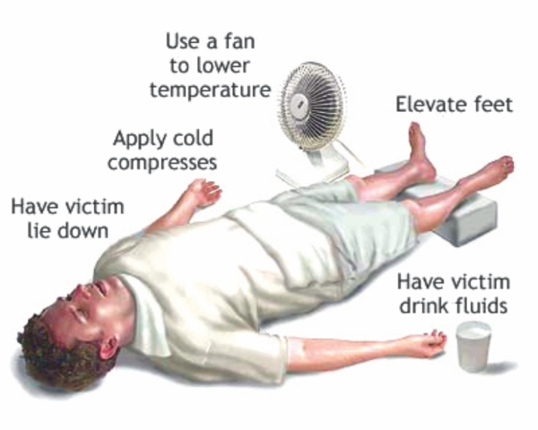
First Aid for Heat Related Reactions
For Heat Exhaustion:
Move the person out of the heat and into a shady or air-conditioned place.
Lay the person down and elevate the legs and feet slightly.
Remove tight or heavy clothing.
Have the person drink cool water or other nonalcoholic beverage without caffeine.
Cool the person by spraying or sponging with cool water and fanning.
Monitor the person carefully.
Contact a doctor if signs or symptoms worsen or if they don't improve within one hour.

Slide 25
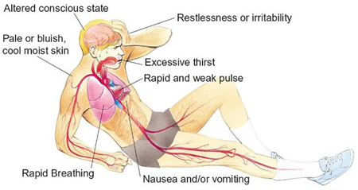
Symptoms of Shock

Slide 26
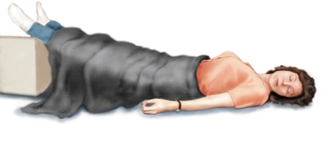
First Aid for Shock
Lay the person down and elevate the legs and feet slightly, unless you think this may cause pain or further injury.
Keep the person still and don't move him or her unless necessary.
Turn the victim’s head to one side if neck injury is not suspected.
Begin CPR if the person shows no signs of life, such as not breathing, coughing or moving.

Slide 27
Requirement 2a Skateboarding
    Explain the following to your counselor:
      History and evolution of skateboarding
      Benefits of skateboarding (physical fitness, balance, coordination, perseverance, and creativity)
      Purpose of skateboarding safety and protective gear (helmets, knee pads, elbow pads, wrist guards)

Slide 28
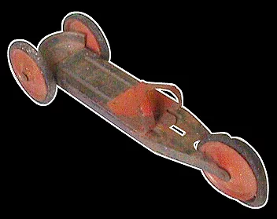
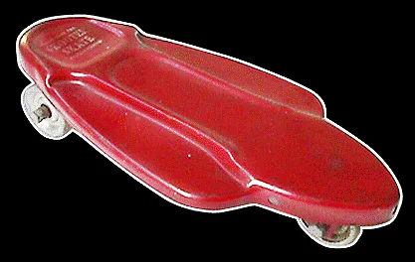
History and Evolution of Skateboarding
1920’s - The first known skateboard type product is a three-wheeled, stamped metal device with pedal-car like wheels, and an adjustable heel cup and toe clip. Usually sold in pairs with a set of poles, it was designed to mimic cross-country skiing. It had no steering mechanism.
1930’s - The “Scooter Skate” is a skateboard/scooter hybrid; it was ridden with its included handle or without. The rocket-ship style metal deck came with steel roller-skate style wheels. There was no turning or steering mechanism.

Slide 29
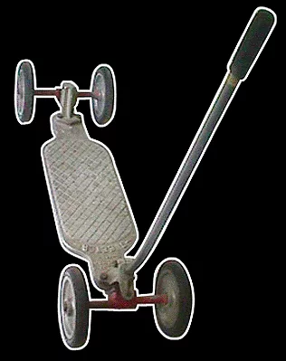
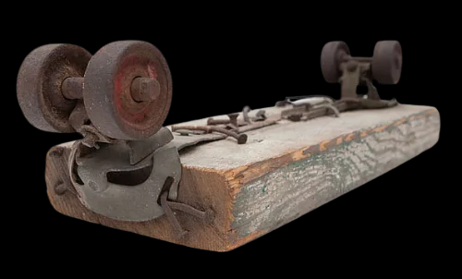
History and Evolution of Skateboarding
1940’s - A four-wheeled “Skeeter Skate” came with a removable handle and pedal-car style wheels. This device introduced the first steering axles, or “trucks,” which allow riders to turn for the first time.
1950’s - A crude form of skateboarding as we know it today begins to develop. Kids create their own homemade boards by nailing roller-skate assemblies to the bottom of a wooden plank. Late in the 1950s, surfers discover skateboarding and embrace the feeling of wave riding on flatland.

Slide 30
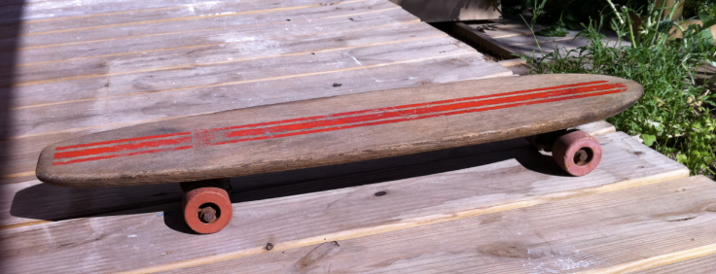
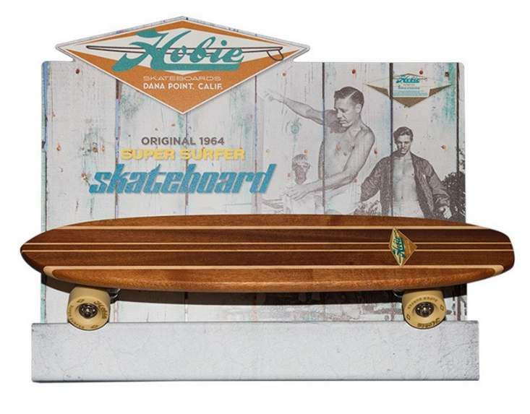
History and Evolution of Skateboarding
1960’s - The early 1960s bring the introducton of the first manufactured skateboards.
1964 - Surf legend Hobie Alter introduces the Hobie Super Surfer skateboard.
1965 - Skateboarding becomes widespread and very popular, and companies are struggling to keep up with demand. While most skaters take to the streets or sidewalks

Slide 31
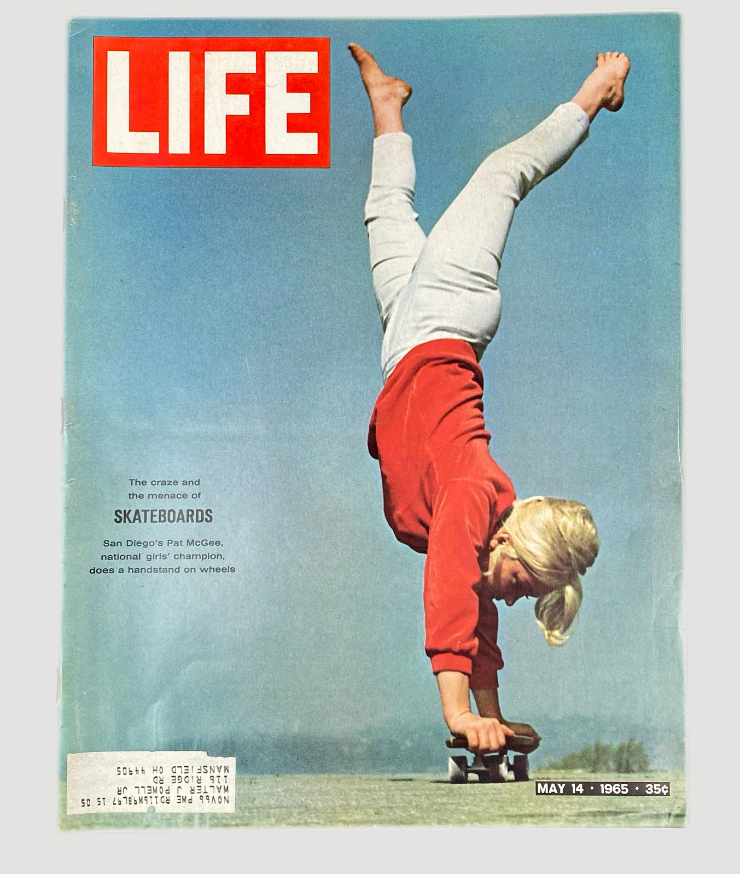
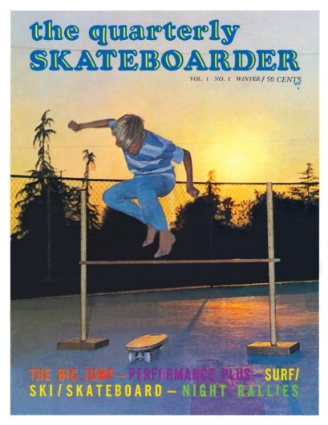
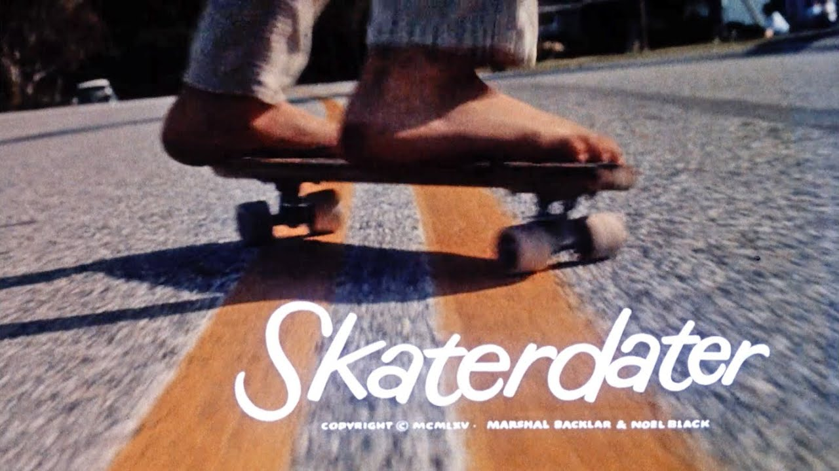
History and Evolution of Skateboarding
1965 - Skateboarding becomes widespread and very popular, and companies are struggling to keep up with demand. Many skaters take to the streets or sidewalks.
Skaterdater is a 1965 American short student film about a group of young boys show their skateboarding skills around town, trying to impress each other.

Slide 32
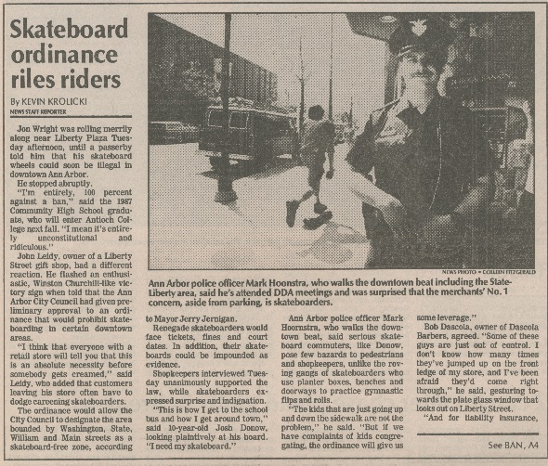
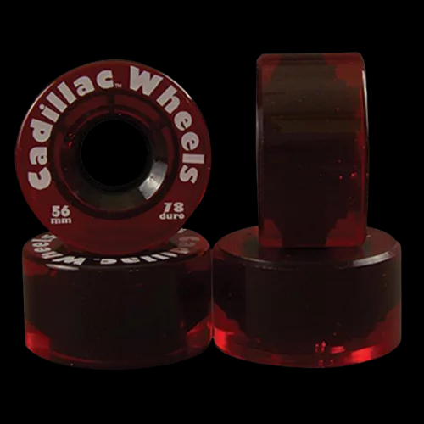
History and Evolution of Skateboarding
1965 - Many public officials and safety organizations begin condemning skateboarding as unsafe – urging stores not to sell skateboards, and parents not to buy them. Many cites start banning skateboarding on public streets. The skateboarding fad dies.
1973-1980 - With the introduction of urethane wheels, empty swimming pools, skateparks, and the ollie, skateboarding regains popularity and spreads to all corners of the globe.

Slide 33
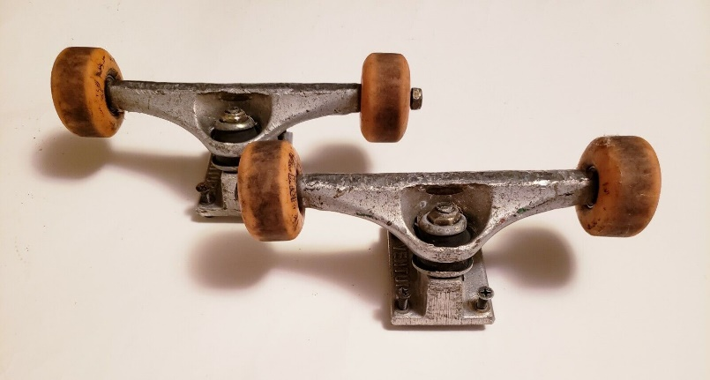
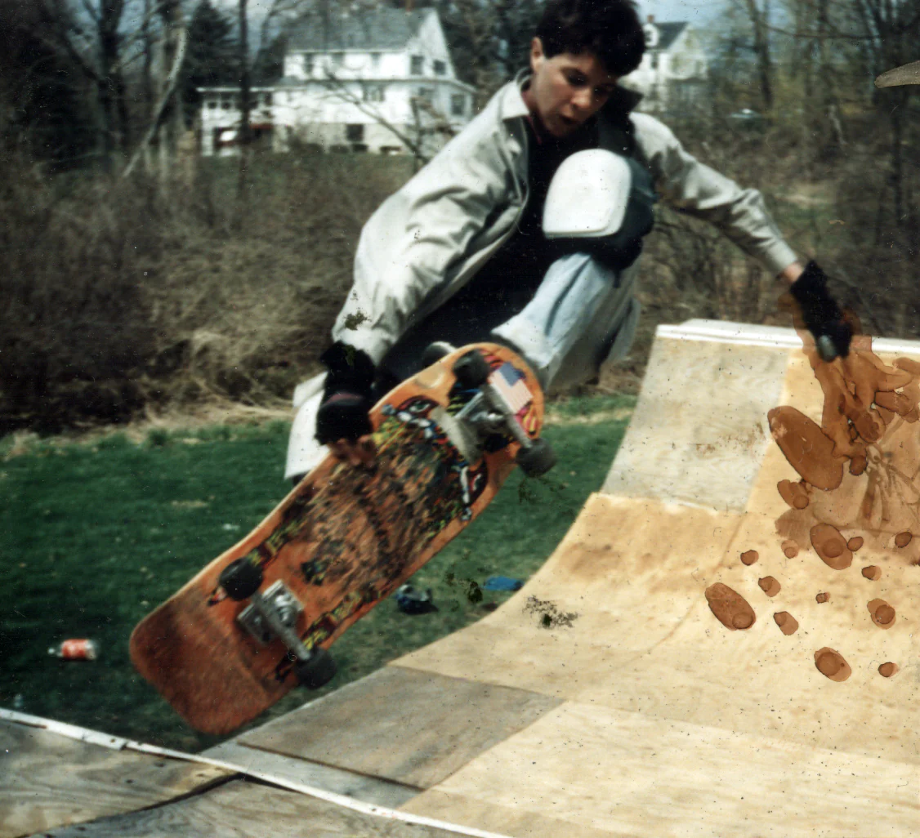
History and Evolution of Skateboarding
1973 - Skateboard trucks specifically designed for skateboarding are introduced. Board manufacturers spring up everywhere and the industry is booming with new products and ideas.
1980’s - Skateboarding interest declines. The majority of skaters move on to other things. Skating goes mostly underground. Street skating and kids building their own wooden ramps keep skating going at the core level.

Slide 34

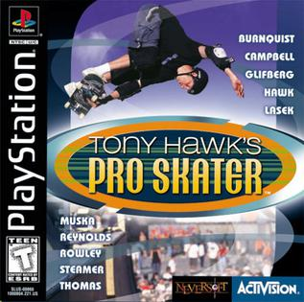
History and Evolution of Skateboarding
1992-1999 - The consolidation era transforms skateboarding into a mainstream sport with millions of fans, spectator-friendly television events, and VHS videos.
1995 - Skateboarding gains a great deal of exposure at the “Extreme Games” in Rhode Island.
1999 - Activision releases "Tony Hawk's Pro Skater," a console video game for PlayStation.

Slide 35
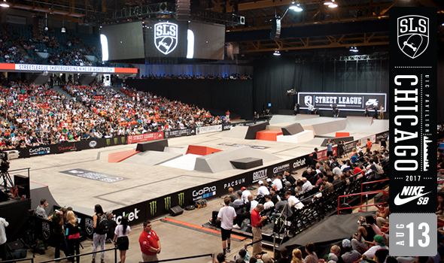
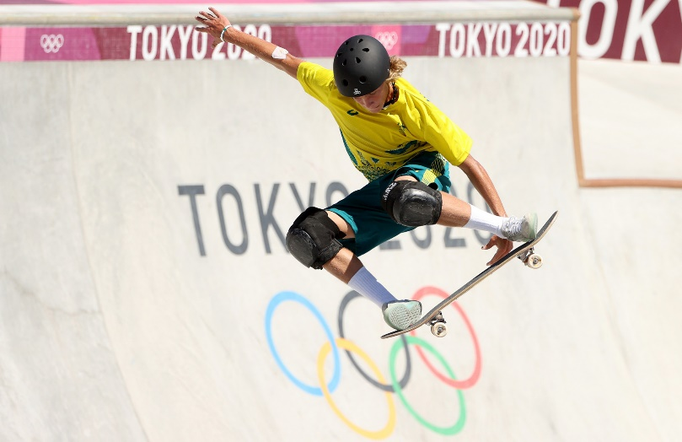
History and Evolution of Skateboarding
2010 - The Street League Skateboarding (SLS) was introduced to boost and grow the sport's popularity worldwide.
2016 - The International Olympic Committee (IOC) announces that skateboarding will make its Olympic debut in Tokyo 2020. The event will feature a street skateboarding and a park skateboarding competition at the Ariake Urban Sports Park;

Slide 36
Requirement 2b Skateboarding
    Explain the following to your counselor:
      Rules and regulations of skateparks
      Understanding skatepark zones (street, bowl, and ramp)
      Right-of-way and respect for others
      Communication signals and warnings

Slide 37
Rules and Regulations of Skateparks
Wearing a helmet, knee pads, elbow pads, and wrist guards is strongly recommended and should be used at all times.
Know your ability and skate accordingly.
The Skatepark has been designed for all skill levels. Please be courteous to other people using the facility.
Do not proceed down a ramp until it is clear of other skaters.
No outside ramps, jumps or other equipment may be brought into park.
No food, beverages, glass containers, radios or boom boxes, tobacco products, alcohol or drugs are permitted in this facility.
Please dispose of litter in trash cans.
Graffiti and/or property defacement is not tolerated
Infractions of rules may result in loss of skating privileges.

Slide 38
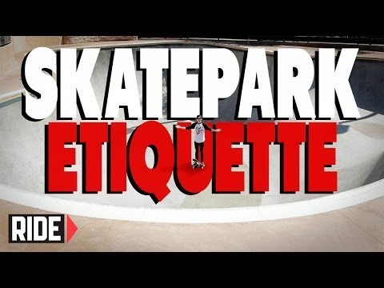
Skatepark Etiquette
Click on the above video for a lesson on the unspoken rules of a skatepark.

Slide 39
Skatepark Etiquette
Wait your turn. Nobody likes the guy that goes after every other person. “Don’t be a snake” always makes the top of skatepark etiquette lists.
Keep your run reasonably short (especially if it’s crowded). If you can do lots of tricks, that’s great. Don’t have marathon runs. Nobody is impressed by your incredible stamina.
Keep the chatter down. Talking about all the tricks you used to know, or what professional skaters you are on a first-name basis with is fine for a cocktail party, but not at the skatepark. People are there to skate.
Skate where it’s appropriate for what you’re trying to learn. Don’t use the bottom of the miniramp for your kickflip clinic, for example.
Be friendly. Nobody likes sharing their recreational time with a jerk. If you’re a skateboarding veteran, don’t use your age to “command respect.”
Don’t be competitive. When the mood is positive and upbeat, the best way to ruin it is to do every trick that other people are doing but just a little bit better. One-upmanship is poor sportsmanship. These “session-killers” aren’t often welcome at the park.

Slide 40
Skatepark Etiquette (cont.)
Don’t post-up in someone’s line. If there’s a ledge that someone is skating, it’s poor form to stand in front of it or, worse, sit down on it and pull out your phone.
Cheer ‘em on. If someone does something big, give them some recognition. This is especially true for secondary users like bikes and scooters. Sharing the love is a great way of creating a good vibe. A common way of showing praise for someone’s effort is to tap your board on the ground. On a similar note, if you were in the wrong and accidentally cut someone off, go ahead and offer a simple apology.
Manage your anger. Getting angry is one thing, but throwing your board around and swearing as loud as your lungs will let you makes you look like a baby. Man-up and accept the fact that skateboarding isn’t always easy.
Bikes: Keep the mud out. Your awesome line through the mud pit into the bowl is leaving a trail of your thoughtlessness.
Lurkers: Don’t mess up the place. You’re there to hang out with your skater friends. That’s great. But as soon as you are vandalizing or littering, it’s time for you to go. In fact, that goes for skaters too.

Slide 41
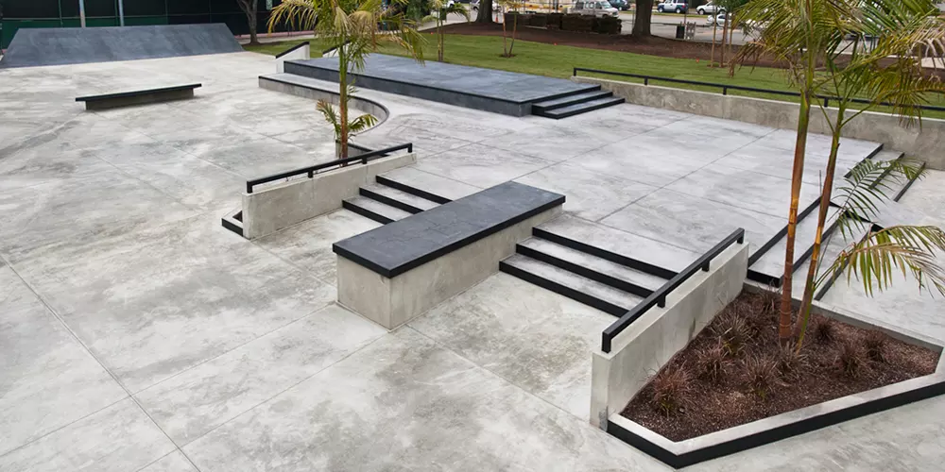
Skatepark Zones – Street
Street plaza parks are the favorite of the vast majority of skaters and they are designed to emulate and improve upon the street skating experience.
Obstacles in a street plaza are styled to look like natural street terrain such as stairs, railings, planters and benches.
Skaters will push off with their feet to gain momentum in a street plaza.

Slide 42
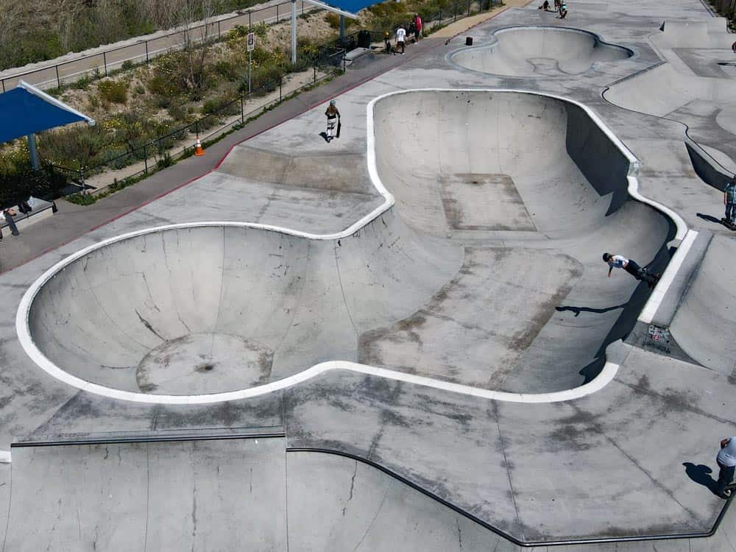
Skatepark Zones – Bowl
The curved walls of bowls allow skaters to ride around and across the bowl in addition to the back and forth skating you might see on a traditional half pipe.
Bowls and bowl parks come in an endless variety of shapes and sizes but most bowls are between 3' and 12' deep.

Slide 43
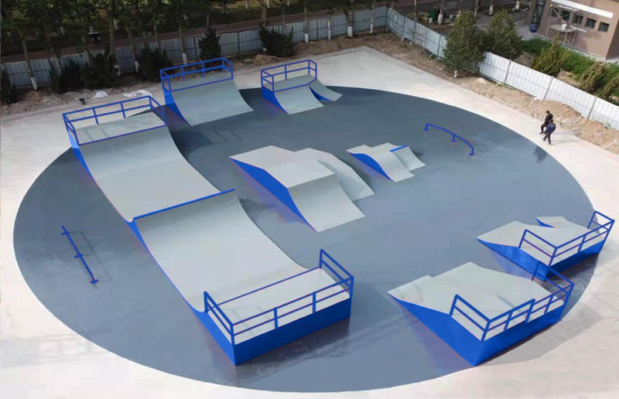
Skatepark Zones – Ramps
Skateboard ramps come in a variety of shapes and sizes, each with its unique features and purposes.
They are designed to give you a little bit of air for moderate flip tricks.

Slide 44
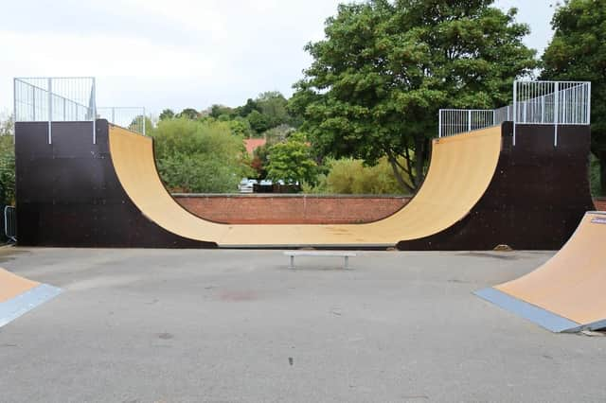
Skatepark Zones – Ramps
Halfpipes are a classic type of skateboard ramp that resembles a vertical U-shape.
They're suitable for more experienced skateboarders and allow for a wider range of tricks

Slide 45
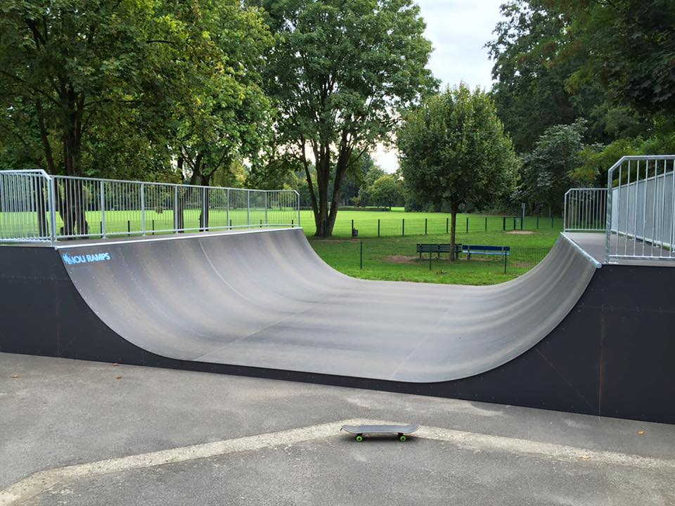
Skatepark Zones – Ramps
Mini Ramps are smaller versions of half pipes, usually no more than four feet tall.
They're ideal for skateboarders who are just starting.

Slide 46
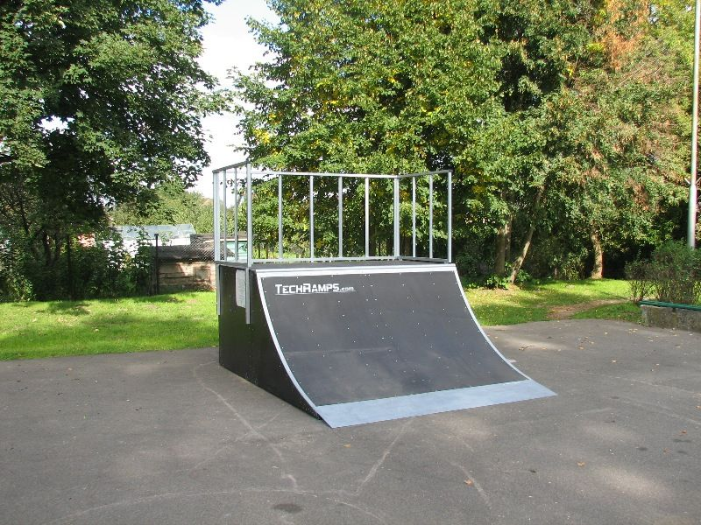
Skatepark Zones – Ramps
Quarter pipes are one of the most popular types of skateboard ramps.
A quarter pipe is just one half of a mini ramp.
Quarter pipes are ideal for skateboarders who are just starting or those who prefer to focus on tricks that involve gaining height.

Slide 47
Right-of-Way and Respect for Others
Rules of the road for skateboards.
  Yield the right-of-way to pedestrians whenever and wherever they are encountered.
  Always yield to the person traveling in front of you.
  Do not impede or interfere with the flow of vehicular traffic.
  Yield to approaching vehicles when entering any roadway.
  When on sidewalks, proceed with due care and at a safe speed.

Slide 48
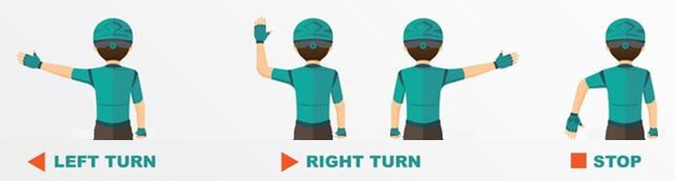
Communication Signals and Warnings
Interaction with Vehicles and Pedestrians:
  Obey traffic control devices, including signs and signals.
  Give an audible warning before passing a pedestrian.
  Similar when riding a bike, use hand and arm signals before stopping or making turns.

Slide 49
Requirement 2c Skateboarding
    Do the following:
      Explain skateboard anatomy (deck, trucks, wheels, bearings)
      Build a board by assembling all pieces (deck, wheels, trucks, bearing, and grip tape) in the proper order
      Explain skateboard maintenance (cleaning, tightening bolts, and replacing parts)

Slide 50
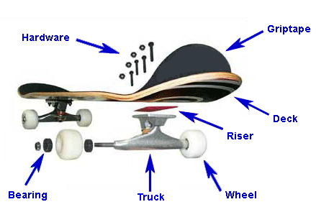
Skateboard Anatomy
The 7 Parts of a Skateboard
A complete skateboard is more than just a deck on wheels—it consists of many different parts, each with their own design and function.
  Deck: A deck is a board upon which a skateboarder stands. Skateboard decks are typically made of seven or nine layers of birch or maple wood that are laminated together and shaped.
  Grip tape: Skateboard grip tape is the adhesive-backed sandpaper affixed to the top of the board to provide traction.

Slide 51
Skateboard Anatomy
The 7 Parts of a Skateboard (cont.)
  Trucks: Skateboard trucks are the front and rear axle assemblies that connect the wheels to the deck and allow the board to turn.
  Wheels: Skateboard wheels are what your board rolls on. They are typically made of polyurethane and measured by their size and hardness.

Slide 52
Skateboard Anatomy
The 7 Parts of a Skateboard (cont.)
  Bearings: Skateboard bearings are round metal discs that fit inside the wheels, mounting them to the axle. The inner and outer parts of the discs ride on interior balls, allowing wheels to turn.
  Hardware: Skateboard hardware includes the nuts, bolts, and screws that hold trucks onto the board. The hanger holds the axle nuts, which keep the wheels affixed to your skateboard. Bushings allow your trucks to turn. Kingpins (the bolts that connect the hanger to the base plate) can alter the height of your trucks.

Slide 53
Skateboard Anatomy
The 7 Parts of a Skateboard (cont.)
  Risers: Skateboard risers are hard plastic pads inserted between the trucks and deck to raise the overall height of the skateboard and avoid wheel bite. Riser pads come in different sizes and are necessary with larger wheels to create enough clearance.

Slide 54
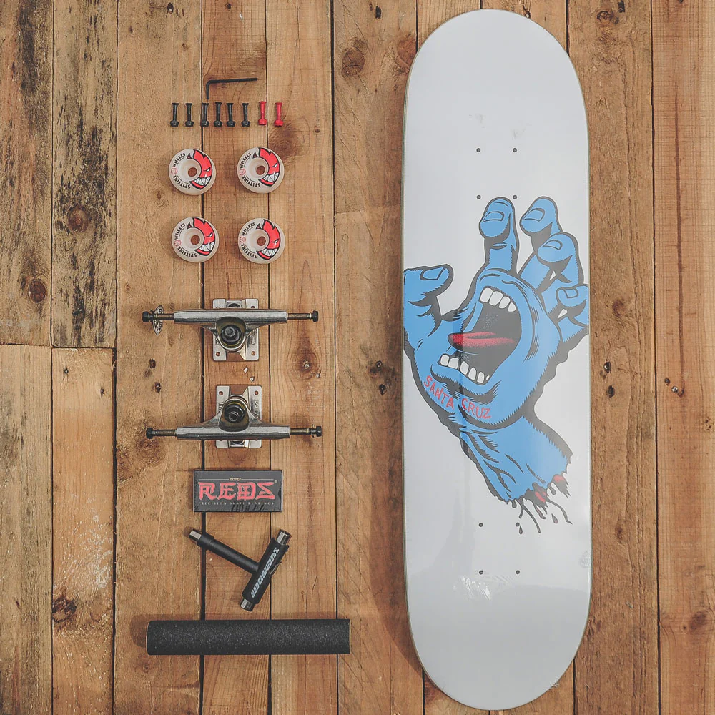
How to Build a Skateboard
You Need The Following Parts:
  Skateboard Deck
  Grip Tape (your deck may already have this applied)
  Trucks
  Truck Bolts
  Wheels
  Bearings
  Skate tool or a selection of spanners

Slide 55
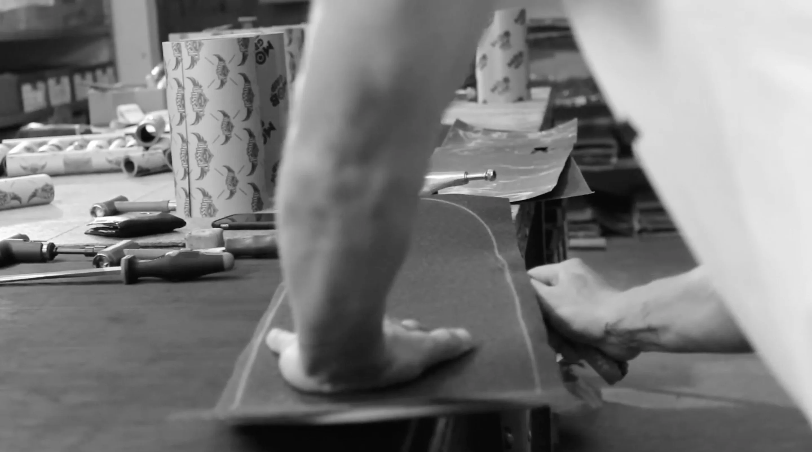
How to Build a Skateboard
Apply the grip tape to the deck.
  Obviously, you can skip this step if your board is already gripped!

Slide 56
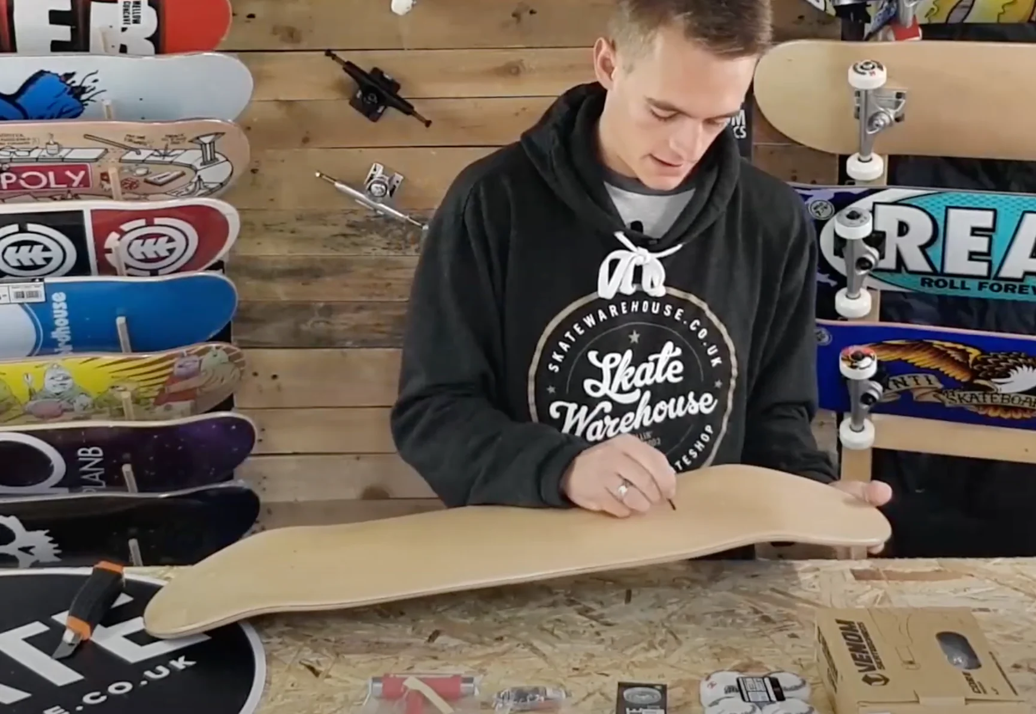
How to Build a Skateboard
Pop the holes through the grip tape for the truck bolts.
  There are 8 holes drilled on a skateboard to accept the 8 truck bolts that fasten the Trucks to the board.
  You can use an Allen Key to carefully make the holes.

Slide 57
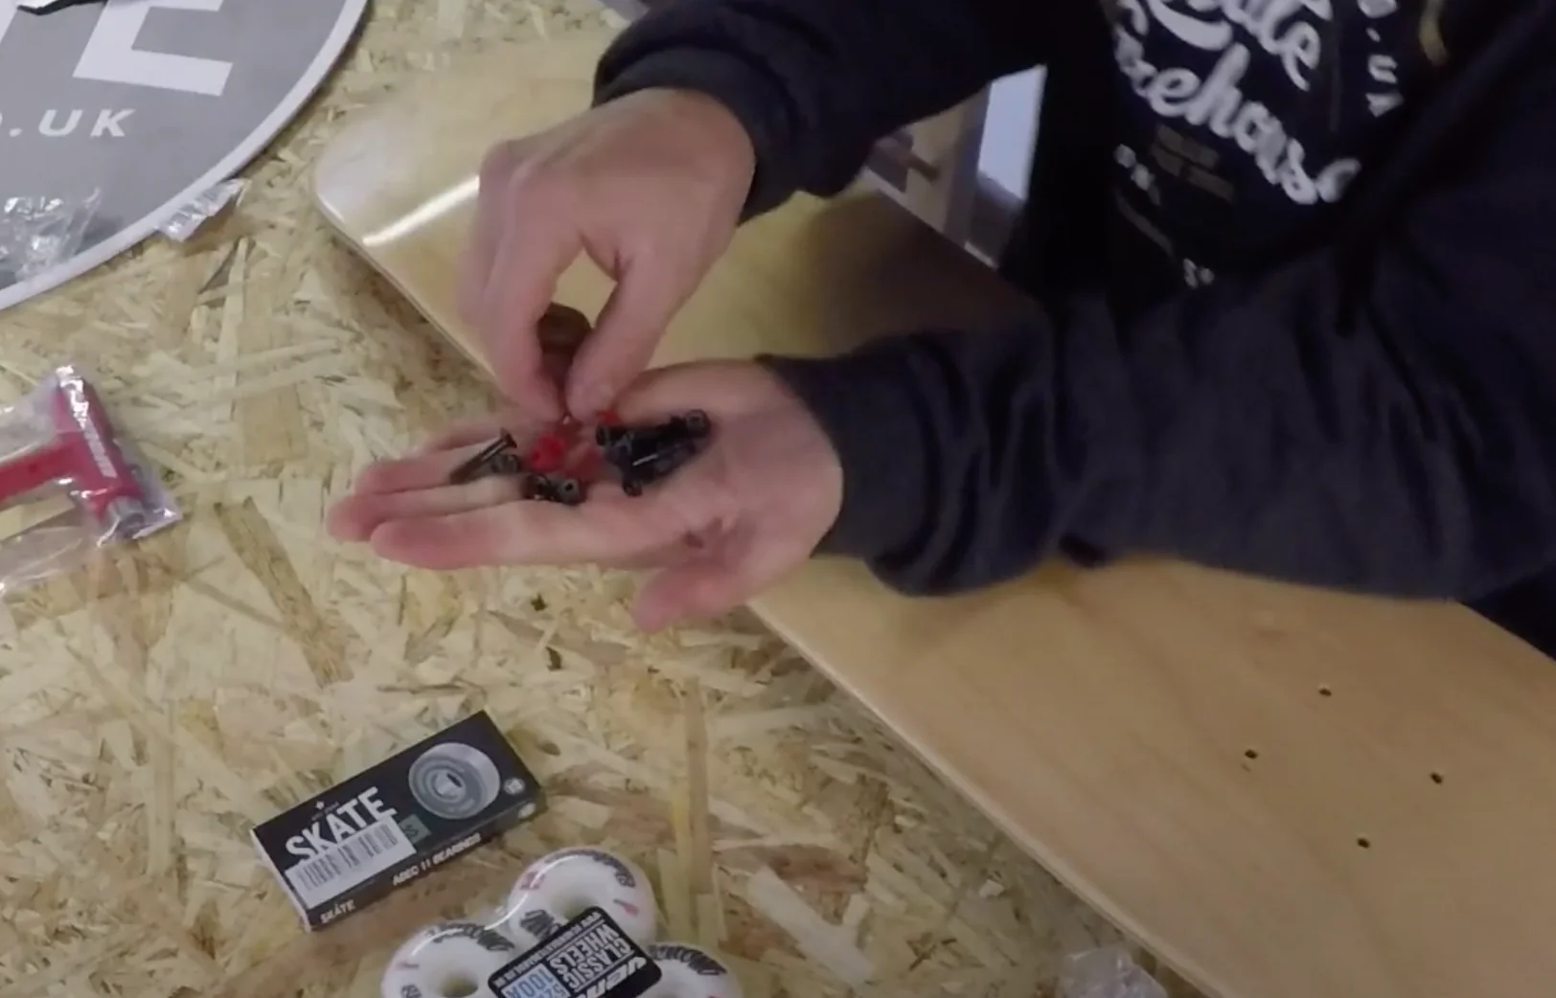
How to Build a Skateboard
Insert the 8 truck bolts through the holes in the grip tape and deck.
  If you have directional bolts then normally you'd place the 2 colored bolts in the 2 holes closest to the nose of your deck.
  This makes it easy to tell which is front and back on your skateboard when riding.

Slide 58

How to Build a Skateboard
Attach your trucks and tighten up the nuts on the truck bolts.
  Don't use power tools to tighten the bolts as this can over tighten causing stress cracks which weaken the deck.
  Make sure your trucks are facing the correct way; the big kingpin nuts should be facing each other towards the middle of the board.
  Get this wrong and your skateboard will turn in the wrong direction and will perform very badly!

Slide 59

How to Build a Skateboard
Fit the bearings into the wheels.
  You need 2 bearings per wheel, fitting them snuggly on each side.
  Place 2 bearings on a truck axle that's facing upwards; push the wheel over the axle and the bearings until you feel the bearing slide into place.
  Flip the wheel over and push down again onto the next bearing – repeat for all 4 wheels.
  DO NOT use a hammer. The hammer will damage your new bearings.

Slide 60

How to Build a Skateboard
Fit the wheels to the truck axles.
  Make sure you have a small Speed Ring Washer on each side of the wheel as this will keep the bearings spinning freely.
  Tighten the axle nuts gradually, constantly check the wheel spins freely but not able to move up and down the axle too much.

Slide 61

How to Build a Skateboard
Fine-tune your setup to get it adjusted to how you prefer it.
  You can tighten the big nut on the trucks called the Kingpin making the skateboard turn less but much more stable.
  This is generally recommended for beginners.

Slide 62

How to Build a Skateboard
Click on the video to help you build your skateboard.

Slide 63

How to Maintain Your Skateboard
Keep your skateboard dry.
Moisture is bad for the bearings, trucks, bolts, and deck.
Avoid skateboarding when it’s raining or when the ground is wet.
Always store your skateboard in a dry place and try to keep it covered if you’re carrying it outside when it’s raining.
If your board’s deck gets too wet, it can get waterlogged and permanently lose its natural “pop.”
Water can cause your board’s bolts, bearings, and screws to rust.

Slide 64

How to Maintain Your Skateboard
Tighten the hardware after every few uses.
Screws, nuts, and bolts can come loose and make it dangerous to skate.
After every few skate sessions, use a screwdriver and a wrench to make sure the screw-top nuts and bolts that hold your board’s trucks in place are all the way tight.
Check all the nuts holding your wheels onto the axles as well.
If the wheels are loose on your axles, for example, one of them could fly off while you’re skating and cause an unexpected wipeout!
When you're tightening your trucks, turn your wrench in small increments—maybe a quarter of a turn on each side.

Slide 65

How to Maintain Your Skateboard
Replace bushings when they break down.
The bushings in your board’s trucks can wear out over time.
All that leaning on your deck and turning is hard on them!
Inspect the bushings regularly for signs of wear like cracks, crumbling, or squishing.
If you see any bad ones, unscrew the nuts and bolts that hold them onto your trucks and swap them out for new ones.
There are two bushings on each truck, a top bushing and a bottom bushing.
You have to remove the truck from the kingpin, or the central bolt that connects the truck to the baseplate, to access the bottom bushing.

Slide 66

How to Maintain Your Skateboard
Clean the bearings every 3 months.
Dirty bearings prevent the wheels from spinning smoothly.
Use a skate tool to unscrew the bolts that hold your board’s wheels in place and take all the wheels off the axles.
Then, remove the bearings from the wheels.
Submerge the bearings in denatured alcohol in a small lidded container and shake the container for 30 seconds.
Take the bearings out and let them air dry for 15 minutes.
Remember which wheel came from which axle when you take them off.
Denatured alcohol is more commonly known as methylated spirits in some countries.

Slide 67

How to Maintain Your Skateboard
Lubricate the bearings every 3 months.
This is the final step to keeping them spinning perfectly.
After you clean the bearings and they are dry, squeeze 2 drops of bearing lube into each bearing.
Hold each bearing between your fingers and give the outer ring a spin to evenly distribute the lube.
Reassemble the wheels, put them back on your board, and you’re ready to ride!
Some bearings have a bearing seal or shield on one side.
Make sure you squeeze the lubricant into the side of the bearing where you can see the little ball bearings inside the rings.
Use a Teflon-based lubricant designed for skateboard bearings or bike chains—a silicone-based product like WD40 will get sticky as it dries.

Slide 68

How to Maintain Your Skateboard
Rotate the wheels every 3 months or sooner.
This evens out the wear on your board’s wheels.
The best time to do this is after you clean your bearings.
Put each wheel back onto the axle diagonal from the axle you took it off of.
For example, put the wheel you took off the front right axle on the back left axle.
If you ride every day or very often, you might want to rotate your wheels as often as every 2 weeks or so to keep them wearing out more evenly.

Slide 69

How to Maintain Your Skateboard
Change the wheels if they start to deteriorate.
A fresh set of wheels keeps your board performing as you want it to.
Watch out for signs that your wheels are shot, such as if they are uneven in size or have flat spots on them.
Remove the old wheels with a skate tool and put a brand new set on.
Besides rotating your wheels regularly, there are other things you can do to make them last longer.
For example, try to skate on smooth surfaces and avoid doing too many power slides.

Slide 70

How to Maintain Your Skateboard
Scrub your deck if it’s really dirty.
You really only have to do this for cosmetic purposes.
To get started, dip a nylon-bristled brush in some warm, soapy water and scrub the grip tape in circular motions.
Next, flip your board over and wipe the underside of the deck clean with a soft sponge and clean water.
Quickly and thoroughly dry the deck off with a clean towel.
If you want to be really thorough, remove the trucks before you clean the underside of the deck to clean the areas they attach to.
If you do so, wait a couple of hours before you reattach them to make sure the deck is totally dry.

Slide 71

How to Maintain Your Skateboard
Sand the edges of the deck if they’re splintering.
This helps prevent chipping, especially near the board’s nose and tail.
Inspect all the edges of your board periodically for rough patches, which are where chips are most likely to occur.
Turn your board on its side on a flat surface, with the rough patch facing up.
Sand back and forth along the rough edge, applying moderate pressure, until it feels smooth again.
Use a sandpaper with a grit somewhere in the range of 120 to 220.
If you use a sandpaper with a lower grit, you might end up taking off too much material and deforming your board.

Slide 72

How to Maintain Your Skateboard
Replace your grip tape when it wears out.
New grip tape can bring a perfectly good old deck back to life.
Carefully, use a utility knife to scrape under the edges of the grip tape and loosen it.
Then, use your hands or a pair of pliers to peel all the grip tape off the deck.
Stick a new piece of grip tape on the deck and trim around the edges with your utility knife.
If it’s hard to peel the grip tape up, heat it up with a hair dryer to loosen the adhesive.
If the edges of your grip tape start to peel up but you don’t want to replace it all yet, just use a utility knife to trim the peeling parts off.

Slide 73
Requirement 2d Skateboarding
    Demonstrate the following skateboarding skills:
      Stance and foot placement (regular and goofy)
      Pushing and balance
      Turning and carving
      Braking and stopping techniques
      Ollies (basic and variations)

Slide 74

How to Stand on a Skateboard
Choose your stance—you can either ride "regular" or "goofy."
In a regular stance, the left foot is situated at the front of the board, whereas in a goofy stance the right foot is up front.
  Determine which stance is more natural for you by considering whether you’re right or left handed.
  Most right handed skaters ride in a regular stance.
  In the end, you should do what feels most comfortable to you.
Give both stances a shot and see which one you prefer.

Slide 75

How to Stand on a Skateboard
Keep your feet shoulder width apart.
Start on flat ground; don’t worry about the skateboard at all right now.
Place your feet directly under your shoulders and assume a natural stance.
In this position, your weight should be evenly distributed over each leg.
This will provide you with maximal balance and control over the board.
Practice shifting your weight back and forth between each leg while keeping your body aligned and your head centered and upright.
This will prepare you to settle into position of stability on the board.

Slide 76

How to Stand on a Skateboard
Bend your knees and sink your weight.
Bring your butt down slightly and bend your knees a little.
This will center your weight in your hips rather than higher up on your body the way it is when you’re standing normally.
With a lower center of gravity, you’ll be less likely to come unbalanced once you’re on the unstable board.
Loosen up; it’s harder to make corrections when you’re rigid.
Don’t crouch or sink too deep; you just want to be low enough to create a solid base.

Slide 77

How to Stand on a Skateboard
Point your head in the direction you’ll be moving.
Turn your chin so that you’re facing the direction you would be going if the skateboard was in motion.
If you favor a regular stance, this means you’ll be looking over your left shoulder; goofy riders will look to the right.
You’ll be able to focus your sight on the ground ahead of you to spot obstacles and ready yourself for tricks, and the position of your feet will also fall within your peripheral vision.
There’s a natural tendency to look down at your feet while you’re trying to keep your balance.
Remember, however, that where your head goes, your body follows.
Stay lined up and get used to looking a few feet ahead of the board.

Slide 78

Staying Balanced on a Skateboard
Step onto the board carefully.
Place one foot on the skateboard and make sure you’ve got solid footing.
Then, quickly and cautiously lift the other foot and set it down beside your first foot.
Your feet should be about shoulder width apart, the way you practiced.
Don’t go too fast or too slow.
If you hurry, you might cause the board to shift unintentionally.
If you take too much time, you could throw yourself off balance standing on one leg.
Aim to step up with an easy 1-2 pattern, with about the same pace that you would walk up stairs.

Slide 79

Staying Balanced on a Skateboard
Position your feet over the trucks.
A good rule of thumb when you’re first getting comfortable with standing on a skateboard is to stay centered over the trucks.
The trucks are the long metal shafts on the underside of the board that attach the wheels to the deck (the wooden platform you stand on).
Rest each foot over the bolts on the top of the board that hold the trucks in place.
Don’t let your feet spread out too far or come together in too narrow a stance.
Conveniently, the distance between the trucks is approximately the same as your feet when in a shoulder width stance.

Slide 80

Staying Balanced on a Skateboard
Avoid the tail and nose of the board.
On either end of most types of skateboards there is an upturned edge known as either the “tail” or the “nose.”
Leave these alone for now.
Putting too much weight on the nose or tail will cause the board to lift up, raising one set of wheels off the ground.
This can lead to a lot of accidents if it’s your first time on a skateboard.
Ensuring that your feet stay over the bolts of the trucks is a good way to keep them from drifting toward either end.
The nose and tail will come into play for more advanced tricks, like manuals, ollies and most other “pop” movements, that require you to manipulate the angle of the board.

Slide 81

Staying Balanced on a Skateboard
Keep your weight on the balls of your feet.
Lean your weight forward slightly until you’re poised on the broad part of your foot directly behind the toes.
When you’re skating, you need to be able to shift and reposition to stay balanced and perform different maneuvers.
Staying on the balls of your feet makes it easier to lift, slide, and pivot your feet at will, and will also allow you to absorb shock through your lower leg muscles while you’re riding.
Standing flat footed on a skateboard feels awkward because it essentially takes all agility out of the equation.
When you’re on the balls of your feet, you’re ready to respond to the movements of the board.
Raising up on tiptoe or letting your heels come off the board will also compromise your balance.
Your entire foot should remain in contact with the top of the board; it’s just a matter of where your weight is directed.

Slide 82

Staying Balanced on a Skateboard
Make small adjustments.
Use delicate movements of the feet, ankles, knees and hips to maintain your balance on the board.
Lean, tilt, pump your legs in order to stay upright.
Wave your arms to steady yourself, if it helps.
Constantly make small adjustments to keep the board under control, especially once you’re in motion.
It will continue to get easier the more you practice.
If your feet and body are fixed in place, you will almost always come unbalanced.
Try not to sway too far forward or backward; you might fall off or even tip the board over.
Balancing on a skateboard is similar to standing on the deck of a boat that is rocking, pitching and swaying.; it forces you to stay light on your feet.

Slide 83

Pushing on a Skateboard
Put your front foot on the board over the front truck (goofy stance – right foot, regular stance – left foot.)
Use your back foot to push off with a long, hard, quick kicking motion. You can do it about 3 to 4 times.
  Walking and pushing are remarkably similar activities.
  You should step onto the board to start with and keep on moving.
  Learn the skill of pushing with your back foot while retaining your front foot on the board.

Slide 84

Pushing on a Skateboard
Use your back foot to push off with a long, hard, quick kicking motion. You can do it about 3 to 4 times.
  Walking and pushing are remarkably similar activities.
  You should step onto the board to start with and keep on moving.
  Learn the skill of pushing with your back foot while retaining your front foot on the board.

Slide 85

Pushing on a Skateboard
Put your left foot on the back screws and twist both feet so they are horizontal and parallel.

Slide 86

Pushing on a Skateboard
When you start to slow down, push off 1 or 2 more times.
A good push-off technique allows a skateboarder to start moving and pick up speed fast.

Slide 87

How to Turn/Carve on a Skateboard
Lean your weight in the direction you want to turn/carve.
Carving is basically shifting your weight either on your heel or toe to turn.
Decide whether you want to turn/carve to the left or to the right.
If you ride regular (left foot up front), initiate a mild left turn by leaning your weight back over your heels, so that more pressure is put on the rear edge of the deck.
Right turns can be performed by leaning over the toes.
The general idea is to simply lean in the direction you want to go.
These directions should be reversed for goofy riders (those who place their right foot up front).

Slide 88

How to Turn/Carve on a Skateboard
Try to keep your balance.
As the deck tilts, all your weight will be over the wheels on one side of the board.
This will cause them to veer in the direction you’re leaning, resulting in a smooth, gradual turn.
Bend your knees and lower your center of gravity slightly as you steer to keep from being forced off balance by the motion of the turn.
If you find yourself falling off to the side of the board, you’re probably leaning too hard.
Don’t be too heavy-footed.
Try repositioning your weight delicately at first and working your way up to wider curves.

Slide 89

How to Turn/Carve on a Skateboard
Adjust your board to make turning easier.
If you find that it’s difficult to perform leaning turns on your board, it may be because your trucks are too tight.
Use a crescent or socket wrench to take a little tension out of the nut that secures and tightens the trucks.
This will enhance their range and ease of motion, allowing you to glide into turns effortlessly.
Looser trucks will make leaning turns easier, but will reduce the overall stability of the board, as the deck will be able to move around more freely around the wheels.
Trucks are the metal axles that hold the wheels on, and there is one in the front and one in the back of the board.
Play around with different levels of tightness in the trucks to strike the right balance between stability and ease of movement.

Slide 90

How to Stop a Skateboard
Tail Scraping
Tail scrape only when going slowly.
  Tail scraping is a very basic stopping method.
  When performing it, you can easily lose control of the board without meaning to.
  Try tail scraping when skateboarding casually on a sidewalk or even ground.

Slide 91

How to Stop a Skateboard
Tail Scraping
Move your non-dominant foot to the back of the skateboard.
  Lean forward, and keep your weight on the balls of your feet.
  Your dominant food should stay near the middle of the skateboard.
  If you loose balance, lift up your arms to steady yourself.

Slide 92

How to Stop a Skateboard
Tail Scraping
Press the tail with your back foot.
  Continue applying pressure until it comes in contact with the ground.
  If you hear a scraping sound, your board is in process of stopping.
  The friction between your skateboard and the ground will slow your speed.
  Do not step off the board until you have come to a complete halt.

Slide 93

How to Stop a Skateboard
Breaking with Your Foot
Footbrake when you're skating on level ground.
  Do not footbrake as an emergency stop or if you're going downhill.
  This method is only useful for casual skating on level ground.
  Because this method will involve using your foot to stop the skateboard, avoid using it if you're wearing flip-flops or open-toed shoes.
  An example of when you would use foot-braking: you are skating down the street and are going faster than you're comfortable with.
  Footbraking is a beginner-friendly way to stop a skateboard.

Slide 94

How to Stop a Skateboard
Breaking with Your Foot
Turn one foot forward.
  To begin your footbrake, turn the toes of your front foot forward.
  You will want them to face the nose of the board for an ideal footbrake.
  Turn your upper body and head forward as you do so.
  It doesn't matter whether you use your left or right foot, but most people use their dominant foot.

Slide 95

How to Stop a Skateboard
Breaking with Your Foot
Transfer your weight to your front foot and bring your back foot down.
  When you feel steady on your front foot, let your back foot fall to the ground.
  Keep your back leg straight as you do so.
  Do not lean on your back foot, or you could fall off the skateboard.
  Try to touch the ground with your heel first.

Slide 96

How to Stop a Skateboard
Breaking with Your Foot
Let your back foot drag lightly across the ground.
  First, apply light pressure to the ground with your shoe as you come to a halt.
  Shift your weight slowly from the front to the back foot.
  If you want to slow down quickly, apply more pressure with your back foot.
  Apply even pressure with your foot for a smooth stop.

Slide 97

How to Stop a Skateboard
Controlled Slide Stopping
Do a controlled slide stop if you're braking downhill.
  Slide stops are ideal if you are going quickly downhill or need to brake fast.
  Use this move instead of jumping off your skateboard (which can cause injuries) unless you are in emergency situations.
  An example of when you'd use slide stopping: you are skating downhill and a car abruptly pulls out in front of you.
  Wear protective gear (such as knee pads and wrist guards) at all times in case you need to make an emergency slide stop.

Slide 98

How to Stop a Skateboard
Controlled Slide Stopping
Place your front foot forward.
  Much like footbraking, move your front foot forward until it is facing the board's nose.
  If you know where your skateboard's front bolts are, position your foot directly above them.

Slide 99

How to Stop a Skateboard
Controlled Slide Stopping
Turn your board at an 180-degree angle.
  Pivot with your upper body, and turn sharply to the side.
  Shift your weight to the side so you can accommodate the swift turn.
  As you're doing so, crouch to your knees and lean forward to prevent falling on your back.
  During this move, your feet will remain on the board at all times.
  Do not drag either foot on the ground.

Slide 100

How to Stop a Skateboard
Controlled Slide Stopping
Place your hand on the road for stability.
  If you start to lean back, place your hand on the road and let it drag (similarly to your back foot while footbraking).
  Wear sliding gloves as you do so to avoid getting road burn on your palms.
  Let the board slide to a stop, and lift your hand back up when it has completely halted.

Slide 101

Ollies
Click on the above video to learn how to do an Ollie.

Slide 102
Requirement 2e Skateboarding
    Demonstrate a total of three skateboarding tricks from the following types:
      Flatland tricks
      Flip and shove-it tricks
      Grind and slide tricks
      Air, grab, bowl and ramp tricks
      Footplant tricks
      Balance tricks

Slide 103

Flatland Tricks
Click on the above video to learn how to do two flatland tricks.

Slide 104

Flip Tricks
Click on the above video to learn how to do two flip tricks.

Slide 105

Shove It Tricks
Click on the above video to learn how to do a Shove It trick.

Slide 106

Grind Tricks
Click on the above video to learn how to do a Grind trick.

Slide 107

Slide Tricks
Click on the above video to learn how to do a Slide trick.

Slide 108

Air Tricks
Click on the above video to learn how to do a Front Side Air trick.

Slide 109

Grab Tricks
Click on the above video to learn how to do Early Grab tricks.

Slide 110

Bowl Tricks
Click on the above video to learn how to skate Bowls.

Slide 111

Ramp Tricks
Click on the above video to learn how to skate Ramps.

Slide 112

Footplant Tricks
Click on the above video to learn how to do the Boneless Footplant.

Slide 113

Balance Tricks
Click on the above video to learn how to do a Manual.

